Slide 1
Software Architecture Design Concepts and Styles
COMP6100001 - Software engineering
Session 09
Kenny Jingga, S.Kom., M.T.

Slide 2
Session 09 – Software Architecture Design Concepts and Styles
Learning objectives
At the end of this session, students will be expected to be able to:
Understand the Purpose and Importance of Software Architecture
Describe Key Architectural Styles and Pattern
Evaluate Architectural Styles for Various Project Requirements
Explore Architectural Decision-Making Through Case Studies

Slide 3
Session 09 – Software Architecture Design Concepts and Styles
Content outline
Architecture concepts
Architectural styles & patterns
Evaluation of styles
Case studies
Architectural decision-making

Slide 4
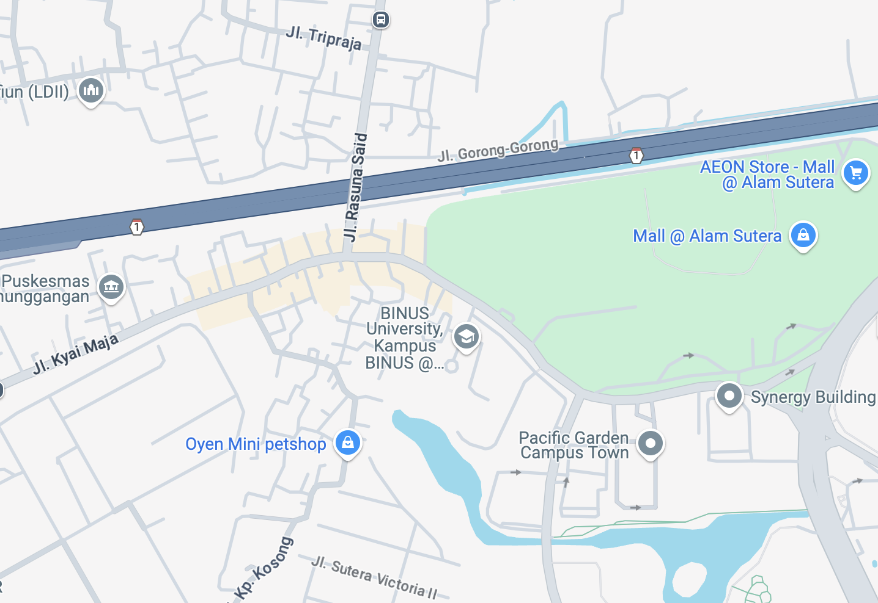
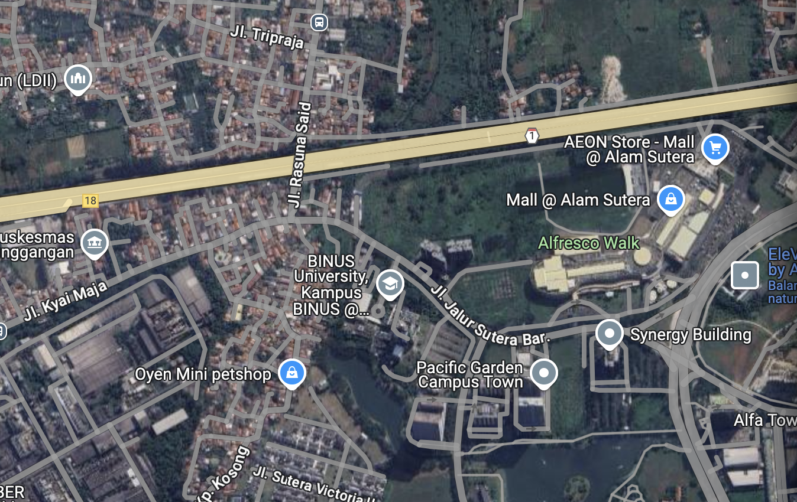
Views and Abstraction

Slide 5
Views and Abstraction
Abstracted views focus on conveying specific information
They have a well-defined purpose
Show only necessary information
Abstract away unnecessary details
Use legends/annotations to remove ambiguity
Multiple views of the same object tell a larger story

Slide 6
Introduction to Software Architecture
definition
Software Architecture refers to the fundamental structures of a software system and the discipline of creating such structures and systems
The software architecture representation is not an operational product
Rather, it is a representation that enables you to
  (1) analyze the effectiveness of the design in meeting its stated requirements,
  (2) consider architectural alternatives at a stage when making design changes is still relatively easy,
  (3) reduce the risks associated with the construction of the software.
  The software architecture of a program or computing system is the structure or structures of the system, which comprise software elements, the externally visible properties of those elements, and the relationships among them
  [Bass et al. 2003]

Slide 7
Introduction to Software Architecture
Definition
Abstraction
Elements: roles, responsibilities, behaviors, properties
Relationships between elements
Relationships to non-software elements
  Hardware, external systems
Described from many different perspectives (views)
“Architecture is about the important stuff. Whatever that is.” – Ralph Johnson

Slide 8
Introduction to Software Architecture
Design vs Architecture: Level of Abstraction
Requirements
  High-level “what” needs to be done
Architecture (High-level design)
  High-level “how”, mid-level “what”
OO-Design (Low-level design, e.g. design patterns)
  Mid-level “how”, low-level “what”
Code
  Low-level “how”

Slide 9
Introduction to Software Architecture
Design vs Architecture: Questions
Design Questions
How do I add a menu item in Eclipse?
How can I make it easy to add menu items in Eclipse?
What lock protects this data?
How does Google rank pages?
What encoder should I use for secure communication?
What is the interface between objects?
Architectural Questions
How do I extend Eclipse with a plugin?
What threads exist and how do they coordinate?
How does Google scale to billions of hits per day?
Where should I put my firewalls?
What is the interface between subsystems?

Slide 10
Introduction to Software Architecture
Importance
Foundation for Development: serves as a blueprint for both the system and the project, laying out the tasks necessary to be executed by the design and implementation teams.
Facilitates Communication: provides a common language and understanding among stakeholders.
Manages Complexity: breaks down complex systems into manageable components.
Supports Quality Attributes: influences performance, security, maintainability, scalability, and other non-functional requirements.

Slide 11

Introduction to Software Architecture
Roles of Software Architecture in Software Engineering
Guides Design and Implementation: architecture sets constraints on the design to ensure consistency and coherence.
Enables Reuse: architectural patterns and styles allow for reusing proven solutions.
Risk Management: early architectural decisions help identify and mitigate risks.

Slide 12
Architectural Styles and Patterns
Architectural Styles
An architectural style defines a family of systems in terms of a pattern of structural organization
Monolithic Architecture
Layered Architecture
Client-Server Architecture
Model-View-Controller (MVC)
Model-View-ViewModel (MVVM)
Event-Driven Architecture
Service-Oriented Architecture (SOA)
Microservices Architecture

Slide 13
Architectural Styles and Patterns
Architectural Styles : Monolithic Architecture
Monolithic architecture is a concept when complete software is developed as a single unit
All functionality, features and modules are developed and integrate and deployed in the form of a single entity
A single platform containing user interface, business logic and database layer on the same page
Monolithic application has a single shared database for each functionality and every feature combined in a single program as a unified model
A monolithic architecture is comfortable and easily adopted by small teams and small projects
A lot of startups and small projects are used to developed using monolithic architecture
It is good for a project when the modules are interdependent and interconnected

Slide 14

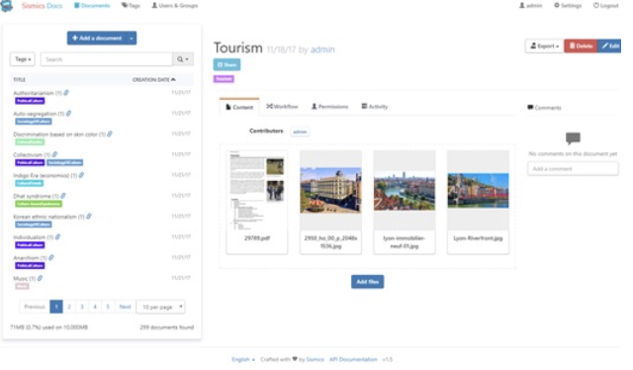
Architectural Styles and Patterns
Architectural Styles : Monoliths make trade-offs on software quality
Several consequences of this architecture on:
Scalability
Reliability
Performance
Development
Maintainability
Evolution
Testability
Ownership

Slide 15
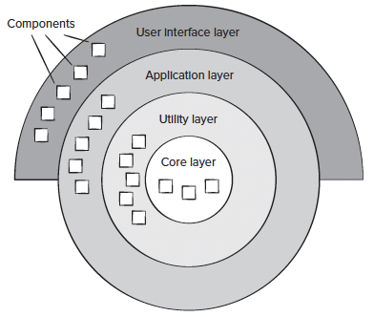
Architectural Styles and Patterns
Architectural Style: Layered Architecture
Organizes the system into layers with related functionality
Layers:
  Presentation Layer: User interface
  Application Layer: Business logic
  Data Access Layer: Database interactions
  Database Layer: Data storage
Advantages:
  Separation of concerns.
  Ease of maintenance and testing.
Disadvantages:
  Can introduce performance overhead due to layer-to-layer communication.

Slide 16
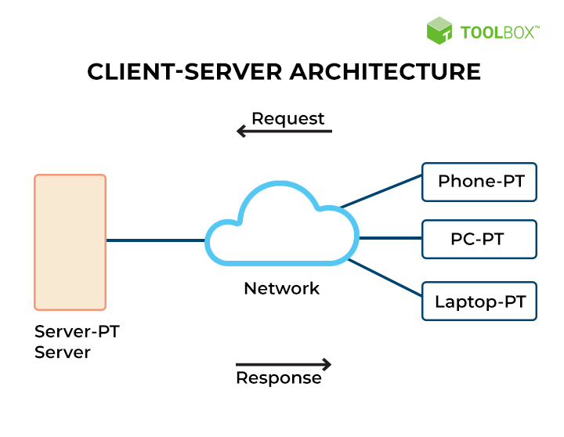
Architectural Styles and Patterns
Architectural Style: Client-server Architecture
Divides the system into two applications, where the client makes requests to the server.
Components:
  Client: Front-end application.
  Server: Back-end application that processes requests.
Advantages:
  Centralized control.
  Scalability by adding more servers.
Disadvantages:
  Single point of failure at the server.
  Network dependency.

Slide 17
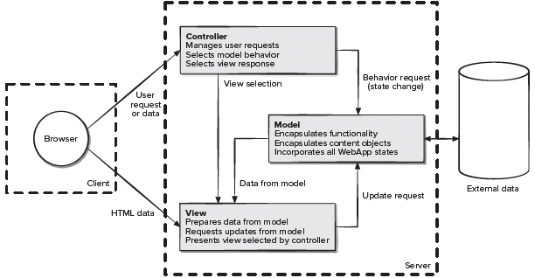
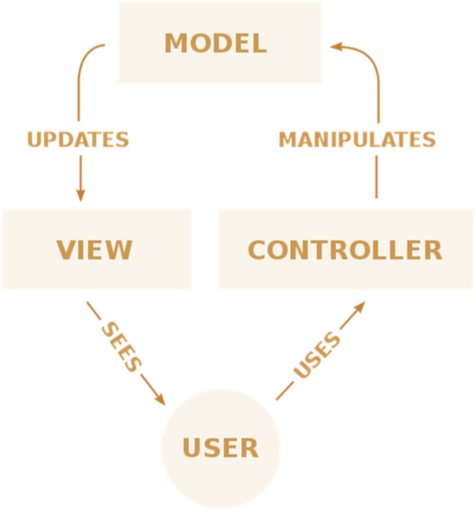
Architectural Styles and Patterns
Architectural Style: Model-View-Controller (MVC)
Separates an application into three main components:
  Model: Manages data and business logic.
  View: Outputs representation of data (UI).
  Controller: Handles input and updates model/view.
Advantages:
  Facilitates parallel development.
  Enhances testability and maintainability.
Disadvantages:
  Can add complexity with multiple components.

Slide 18
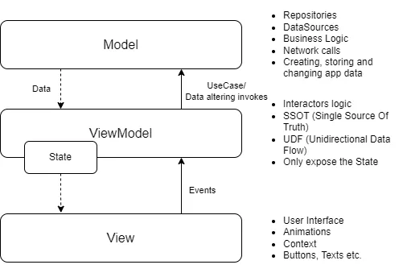
Architectural Styles and Patterns
Architectural Style: Model-View-ViewModel (MVVM)
Enhances MVC by introducing a ViewModel that acts as an intermediary between the View and the Model.
Components:
  Model: Data and business logic.
  View: UI elements.
  ViewModel: Handles the logic for the View, facilitates data binding.
Advantages:
  Promotes a clear separation between the development of UI and the business logic.
  Facilitates unit testing of the ViewModel.
Disadvantages:
  May introduce complexity due to data binding and event management.

Slide 19
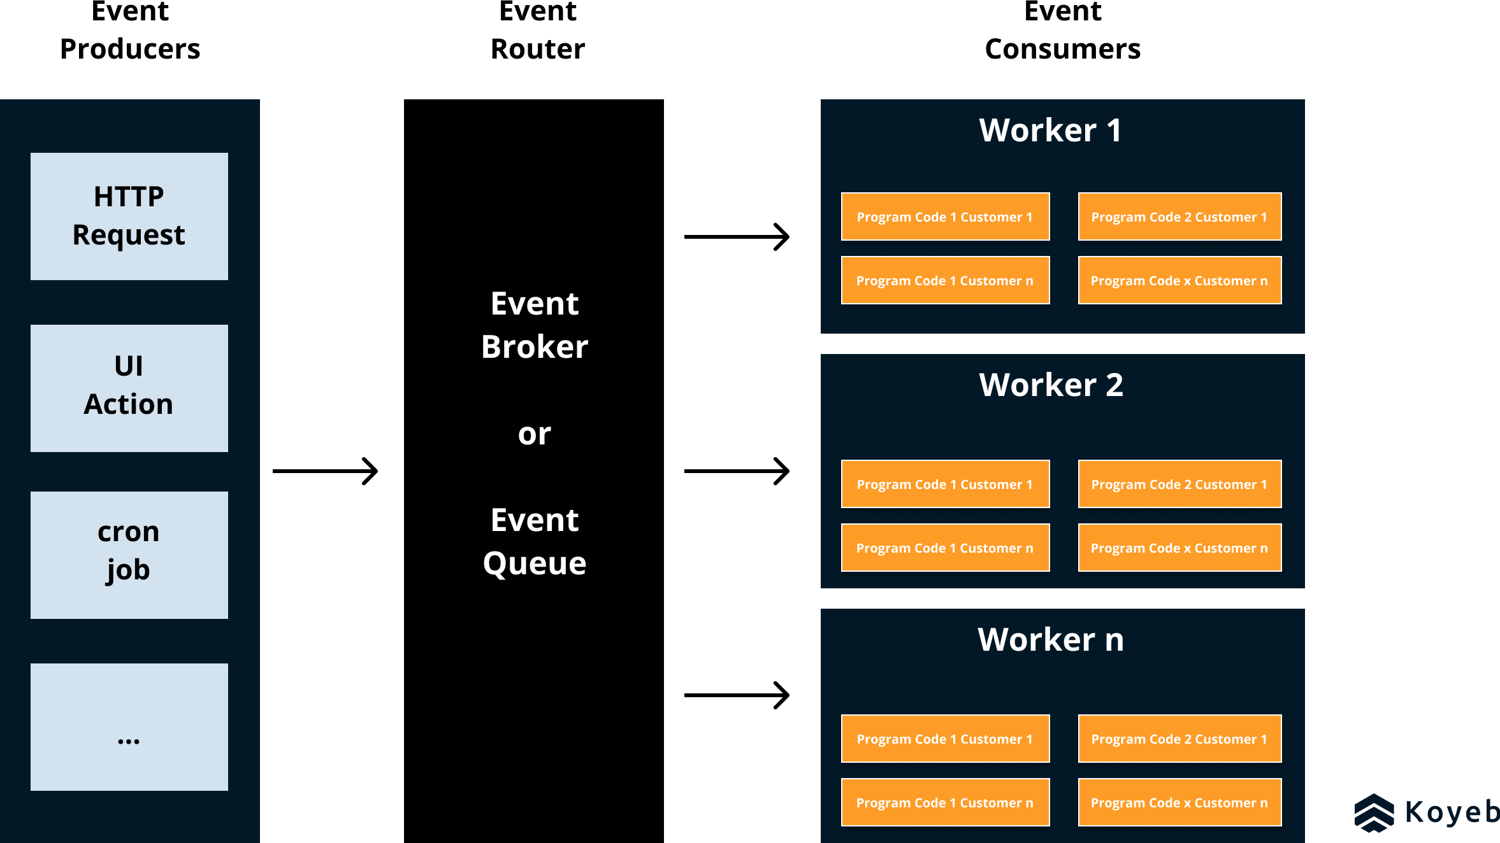
Architectural Styles and Patterns
Architectural Style: Event-Driven Architecture
Components communicate by producing and responding to events.
Components:
  Event Producers: Generate events.
  Event Consumers: React to events.
Advantages:
  Highly decoupled.
  Scalable and flexible.
Disadvantages:
  Debugging can be difficult.
  Potential for message loss if not handled properly.

Slide 20
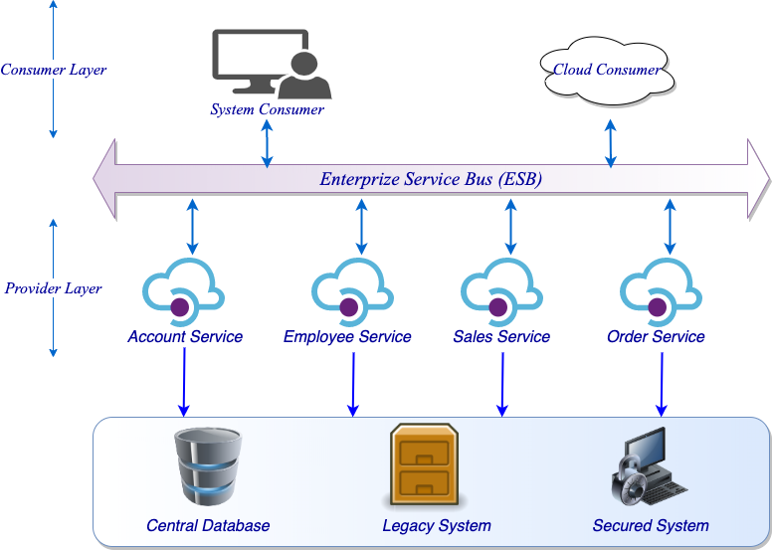
Architectural Styles and Patterns
Architectural Style: Service-Oriented Architecture (SOA)
Services are provided to other components by application components, through a communication protocol over a network.
Characteristics:
  Reusable services.
  Standardized service contracts.
Advantages:
  Promotes interoperability.
  Facilitates integration with legacy systems.
Disadvantages:
  Overhead of service communication.
  Complexity in service management.

Slide 21
Architectural Styles and Patterns
Architectural Style: Service-Oriented Architecture (SOA)
Service-oriented architecture some time is also known as centralized oriented architecture, is architecture when multiple, services which are also said as user agents are used or created interaction with a centralized system to make our traditional monolithic less burden and loosely coupled
A service-oriented architecture is specifically designed to communicate interoperable systems
Each service provides functionality on abstraction level, consider as a black box, self-contained to avoid the overhead of new development each time
The communication between them can be done using a central point of connectivity called Enterprise service bus
ESB is taking care of all service and helping them to interact with each other

Slide 22
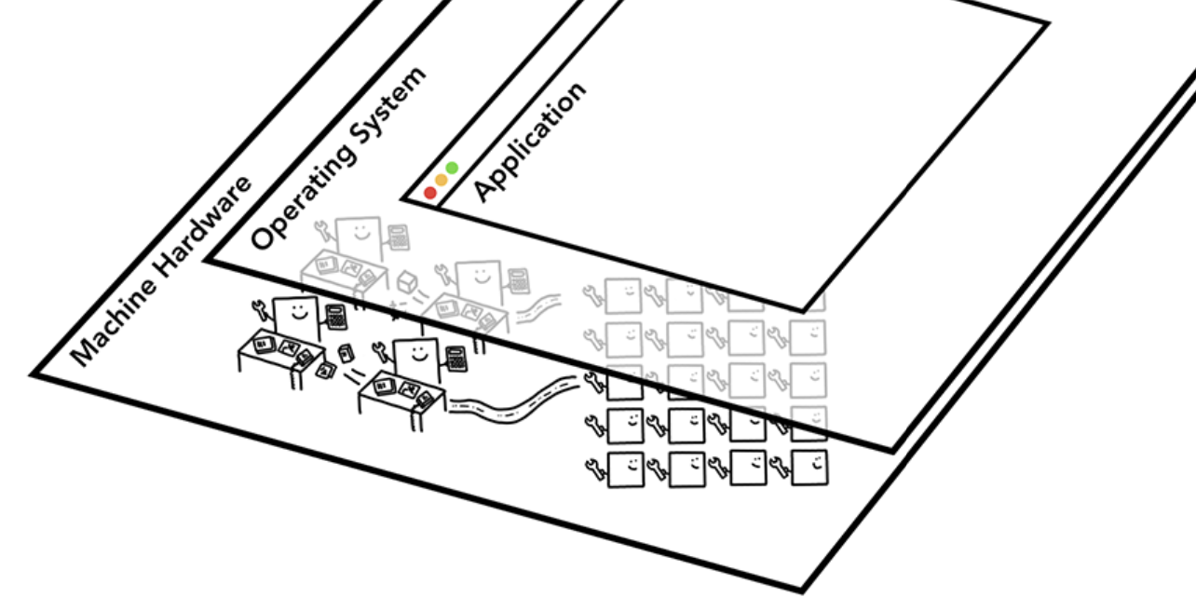
Service-Oriented Architecture
Web Browsers: Chrome
Source: https://developers.google.com/web/updates/2018/09/inside-browser-part1 (CC BY 4.0)

Slide 23
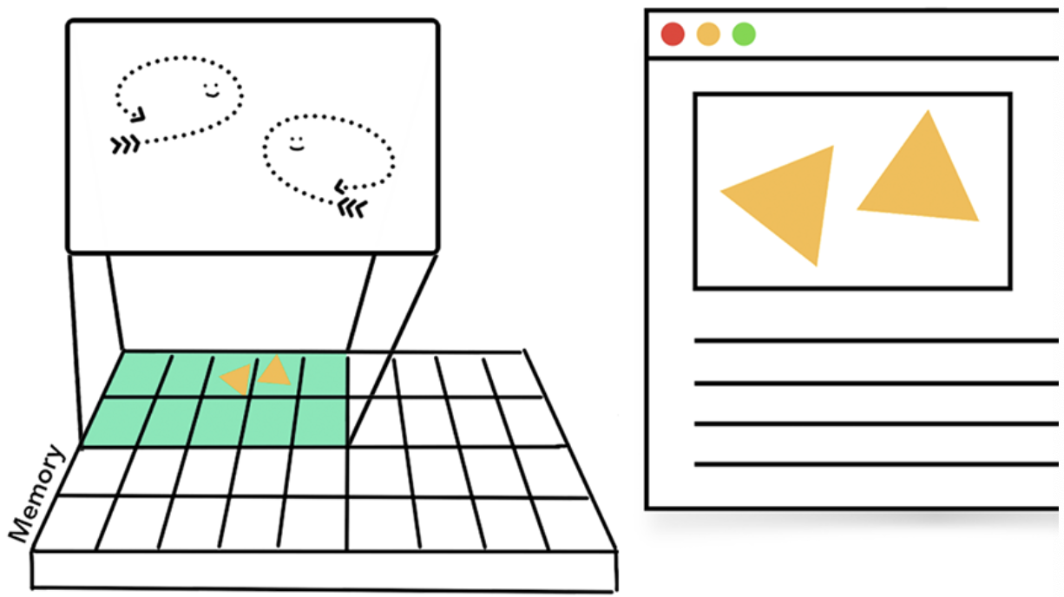
Service-Oriented Architecture
Browser: A Multi-threaded process

Slide 24
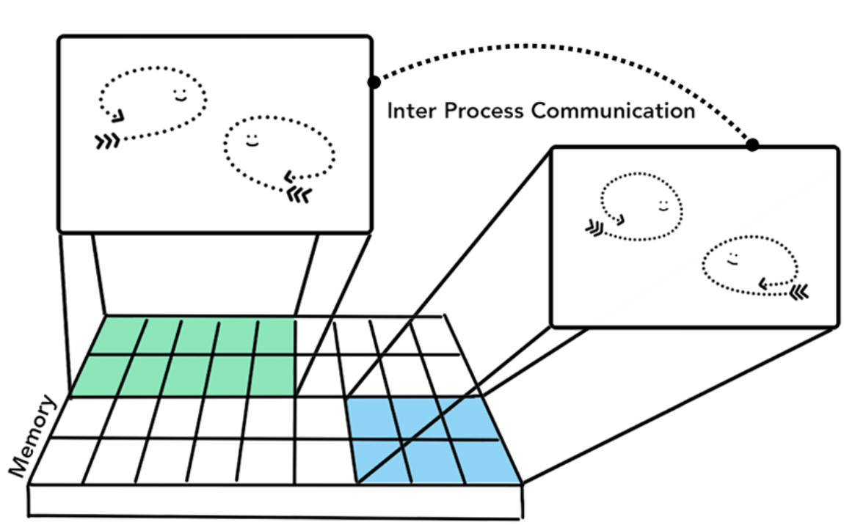
Service-Oriented Architecture
Multi-Process Browser with IPC

Slide 25
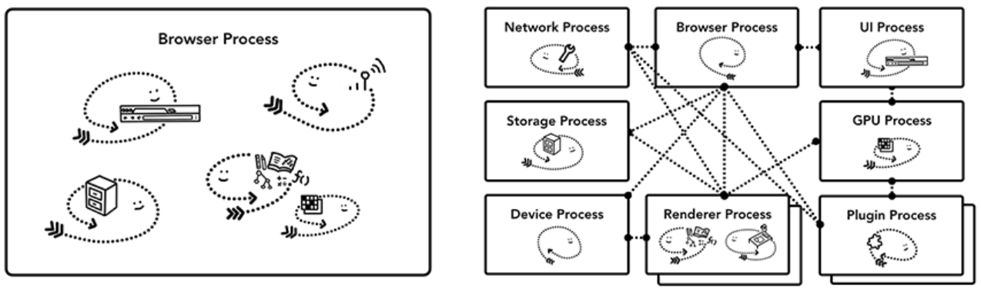
Service-Oriented Architecture
Browser Architecture

Slide 26
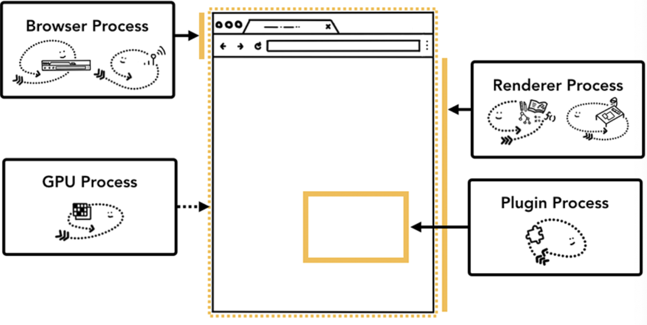
Service-Oriented Architecture
Service-based Browser Architecture

Slide 27
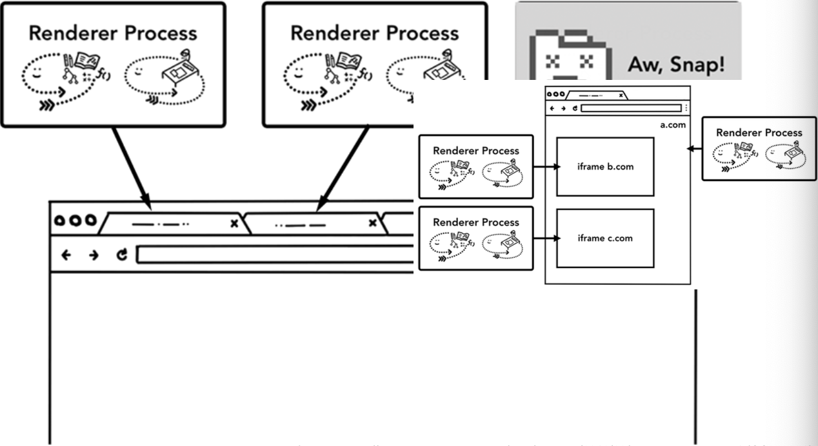
Service-Oriented Architecture
Service-based Browser Architecture

Slide 28
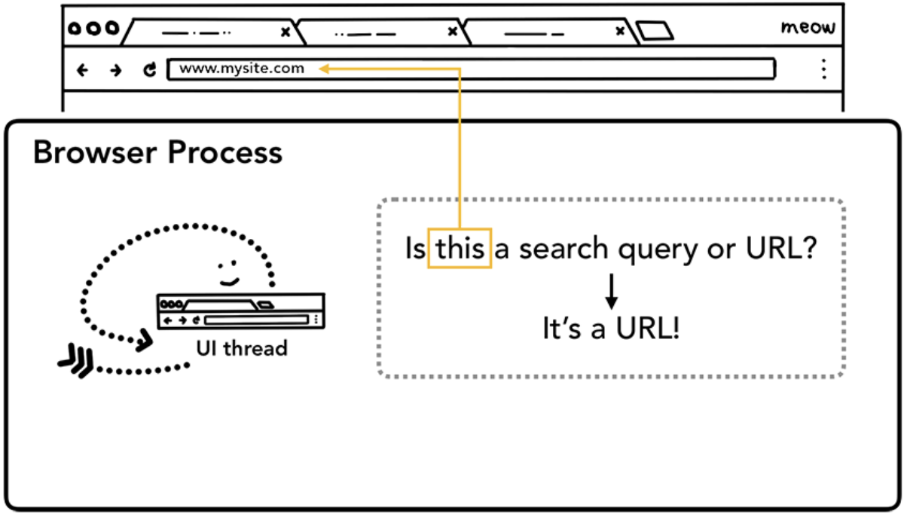
Service-Oriented Architecture
Navigating to a web site uses service requests

Slide 29

Service-Oriented Architecture
Navigating to a web site uses service requests

Slide 30
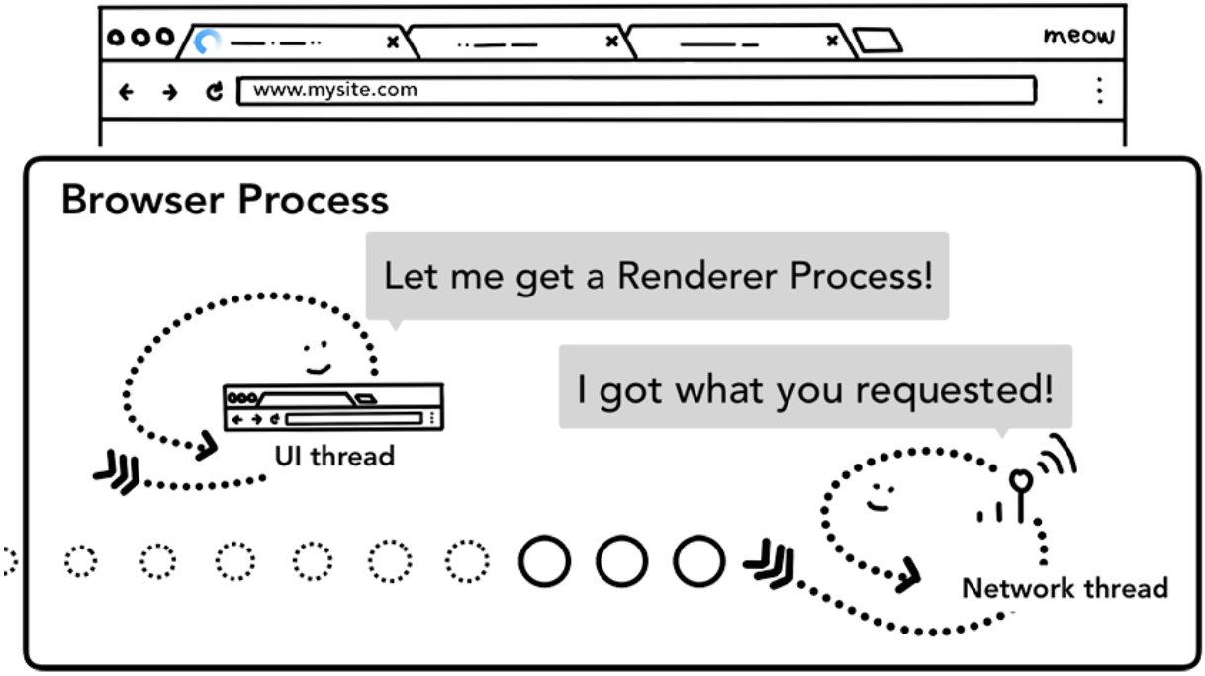
Service-Oriented Architecture
Navigating to a web site uses service requests

Slide 31
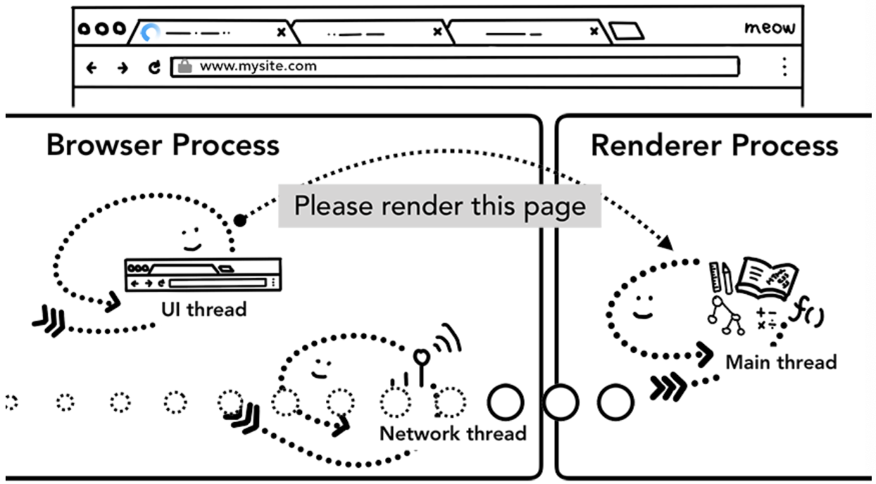
Service-Oriented Architecture
Navigating to a web site uses service requests

Slide 32
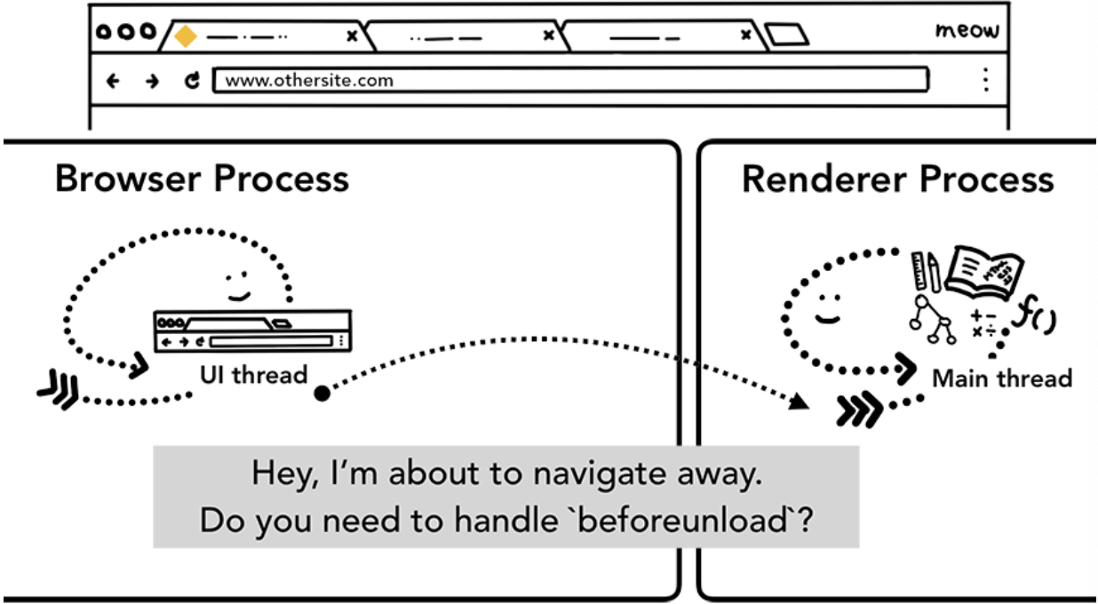
Service-Oriented Architecture
Navigating to a web site uses service requests

Slide 33
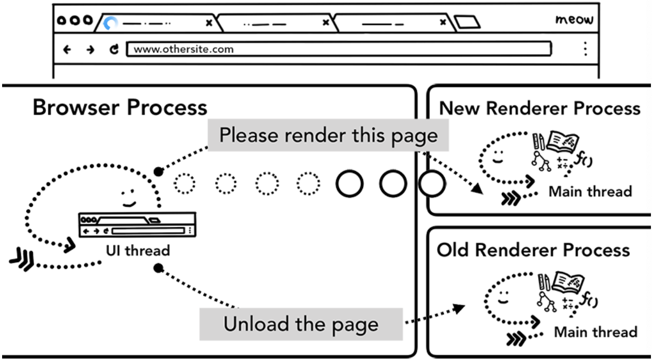
Service-Oriented Architecture
Navigating to a web site uses service requests

Slide 34
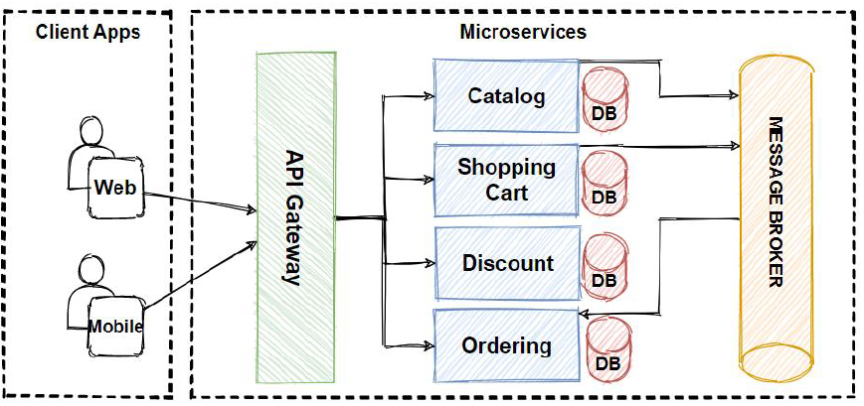
Architectural Styles and Patterns
Architectural Style: Microservices Architecture
Services are provided to other components by application components, through a communication protocol over a network.
Characteristics:
  Reusable services.
  Standardized service contracts.
Advantages:
  Promotes interoperability.
  Facilitates integration with legacy systems.
Disadvantages:
  Overhead of service communication.
  Complexity in service management.

Slide 35
Microservice Architecture
Microservice architecture also considers as decentralized architecture, is much similar to SOA but not connected with any central service
Microservice architecture is an architecture which is build using autonomous services which communicate with each other using rest
Like SOA, microservice not build on such service which can use again any other project as well instead its focus is to make each functionality separate as a service which should be micro and a self-contained, application, business, infrastructure and enterprise layer
Each service unit has its database
All those microservice then join into UI microservice to show as a working application
From UI we call those microservices through rest calls

Slide 36
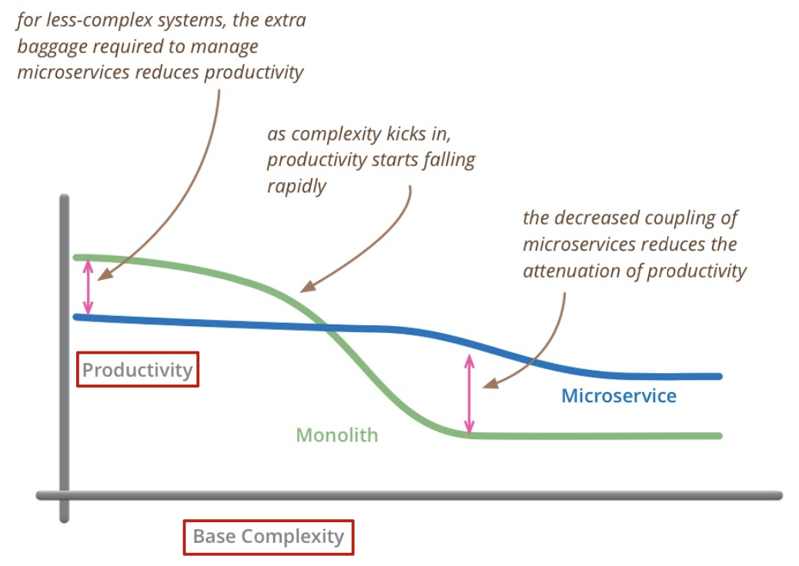
Microservice Architecture
Are microservices always the right choice?
Microservices overhead

Slide 37
Microservice Architecture
Challenges
Complexities of distributed systems
  network latency, faults, inconsistencies
  testing challenges
Resource overhead, RPCs
  Requires more thoughtful design (avoid ”chatty” APIs, be more coarse-grained)_
Shifting complexities to the network
Operational complexity
Frequently adopted by breaking down monolithic application
HTTP/REST/JSON communication
  Schemas?

Slide 38
Architectural Styles and Patterns
Architectural Patterns vs Design Patterns
Architectural Patterns:
  High-level strategies that concern large-scale components, the global properties, and mechanisms of a system.
  Examples: Layered architecture, Microservices.
Design Patterns:
  Solutions to recurring problems in software design at a lower level, focusing on implementation.
  Examples: Singleton, Observer, Factory Method.
Comparison:
Scope - Architectural Patterns: System-level structure and Design Patterns: Component-level design
Abstraction Level - Architectural Patterns: High and Design Patterns: Low
Focus: Architectural Patterns: Overall system organization and Design Patterns: Implementation details

Slide 39
Evaluating Architectural Styles for Different Projects
Criteria for selection
Functional Requirements:
  Does the style support the required functionality?
Non-Functional Requirements (Quality Attributes):
  Performance: Response time, throughput.
  Scalability: Ability to handle growth.
  Security: Protection against threats.
  Maintainability: Ease of making changes.

Slide 40
Evaluating Architectural Styles for Different Projects
Matching Architecture to Requirements
Use Cases and Scenarios:
  Analyze how the architecture handles specific situations.
Architecture Tradeoff Analysis Method (ATAM):
  Evaluate architectural decisions based on quality attribute priorities.

Slide 41
Evaluating Architectural Styles for Different Projects
Trade-offs in Architectural Decisions
Complexity vs. Simplicity:
  More complex architectures may offer flexibility but can be harder to understand and maintain.
Performance vs. Scalability:
  Optimization for performance might affect scalability.
Time-to-Market vs. Robustness:
  Rapid development can lead to technical debt.

Slide 42

Case Studies on Software Architecture
Netflix - Microservices

Slide 43
Case Studies on Software Architecture
Netflix Microservices – App Boot
As of 2016
Recommendations
Trending Now
Continue Watching
My List
Metrics

Slide 44
Case Studies on Software Architecture
Microsoft Word - Layered Architecture
Background:
  Utilizes a layered architecture to separate concerns.
Layers:
  UI Layer, Business Logic Layer, Data Access Layer.
Benefits:
  Improved maintainability and flexibility.

Slide 45
Case Studies on Software Architecture
Discussion on Architectural Choices and Outcomes
Success Factors:
  Alignment with business goals.
  Proper evaluation of trade-offs.
Lessons Learned:
  Importance of scalability considerations.
  Need for thorough testing in distributed architectures.

Slide 46
Architectural Decision-Making Process
Discussion on Architectural Choices and Outcomes
Stakeholder Involvement
Identifying Stakeholders:
  Developers, customers, end-users, project managers.
Gathering Requirements:
  Both functional and non-functional requirements.
Collaborative Decision-Making:
  Involving stakeholders in evaluating options.
Documentation and Communication
Architectural Descriptions:
  Use of UML diagrams, architectural blueprints.
Communication Tools:
  Documentation repositories, wikis, meetings.
Importance of Clarity:
  Ensures everyone has a shared understanding.
Notes:
ISO/IEC/IEEE 42010:2011. Systems and software engineering — Architecture description.

Slide 47
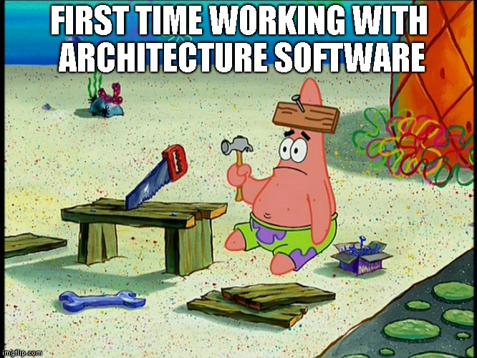

Slide 48
References
Titus Winters, Tom Manshreck, and Hyrum Wright. (2020). Software Engineering at Google: Lesson Learned from Programming Over Time. 1st. O’Reilly Media. California. ISBN: 978-1492082798.
Roger Pressman and Bruce Maxim. (2020). Software Engineering: A Practitioner's Approach. 9th. McGraw Hill. New York. ISBN: 978-1259872976.
Ian Sommerville. (2016). Software Engineering. 10th. Pearson. London. ISBN: 978-1-292-09613-1.

